Slide 1
Data Visualization SONYC

Slide 2
Literature review notes

Slide 3
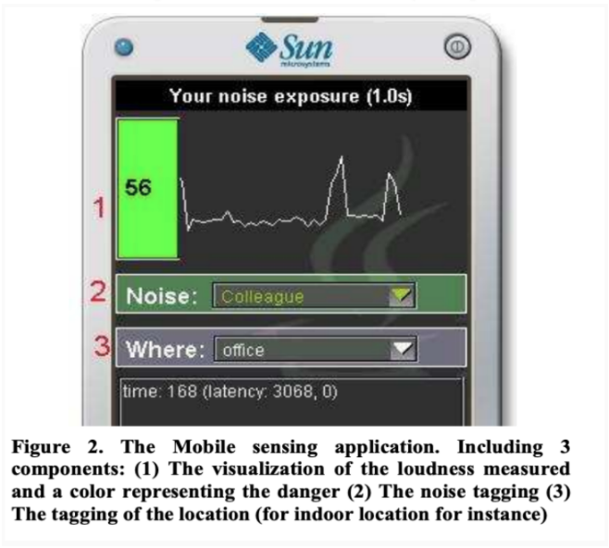
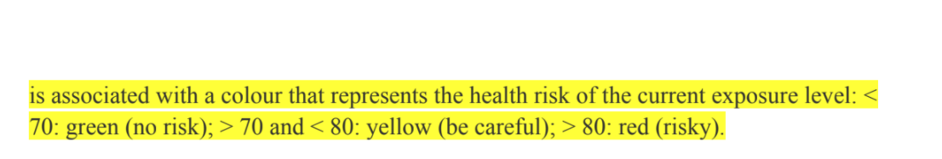
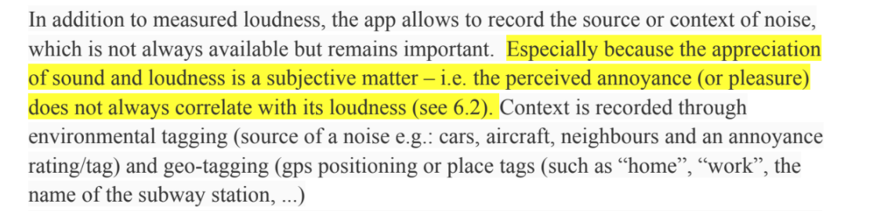
Citizen noise pollution monitoring

Slide 4
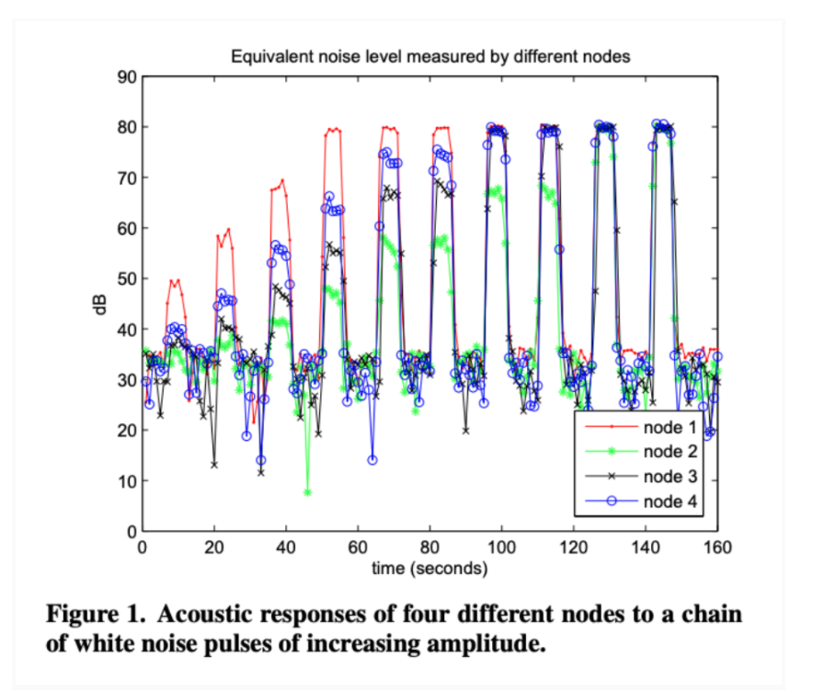
First experiences using wireless sensor networks for noise pollution monitoring.
Authors mention that current tools often do not provide satisfactory data processing and visualization features and propose using Matlab as it serves scientists in managing, processing and visualizing their data and appears therefore particularly well-suited to be used in the context of wireless sensor networks.

Slide 5
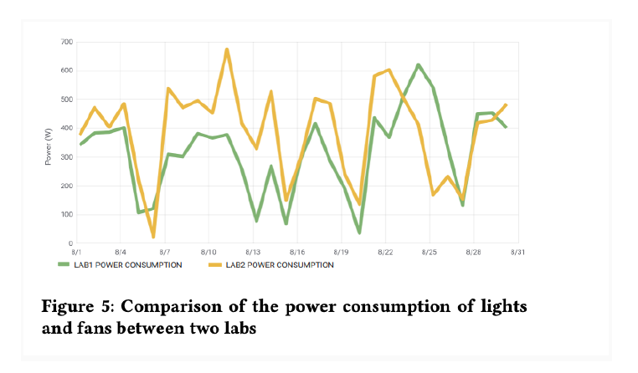
Database and Caching Support for Adaptive Visualization of Large Sensor Data
Authors advise against displaying too many data points on a single screen as it can make the visualization slow, increase network usage and render the interface less informative and cluttered.
Authors used Grafana as a visualization interface for their experiments since it is a widely used open-source tool, provides data customization and allows creating dashboards with attractive visualizations.
Notes:
grafana---back-end

Slide 6
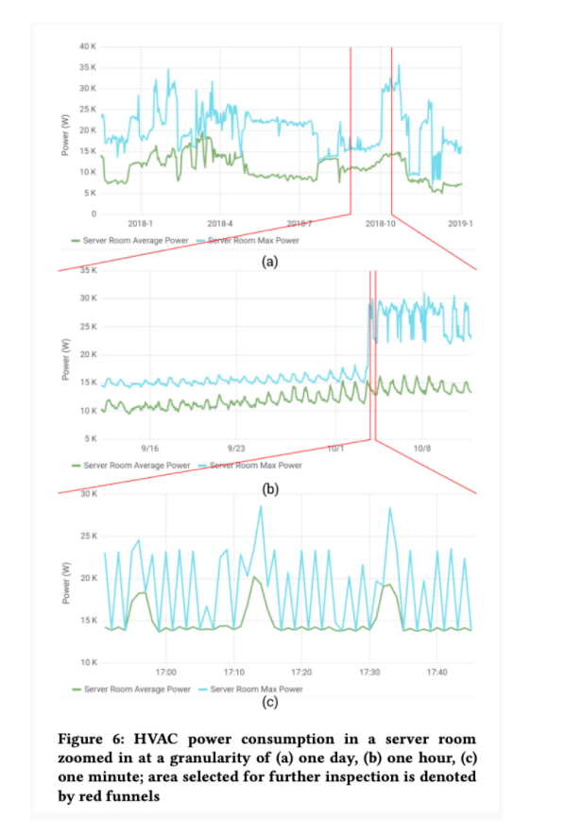
Database and Caching Support for Adaptive Visualization of Large Sensor Data
The user can zoom in to the desired section to view lower granularity data, based on the visual inspection of this graph. The visualization interface enables a smooth transition between granularities to provide rich user experience as shown in Figure 6
Notes:
data

Slide 7
Web accessibility notes

Slide 8
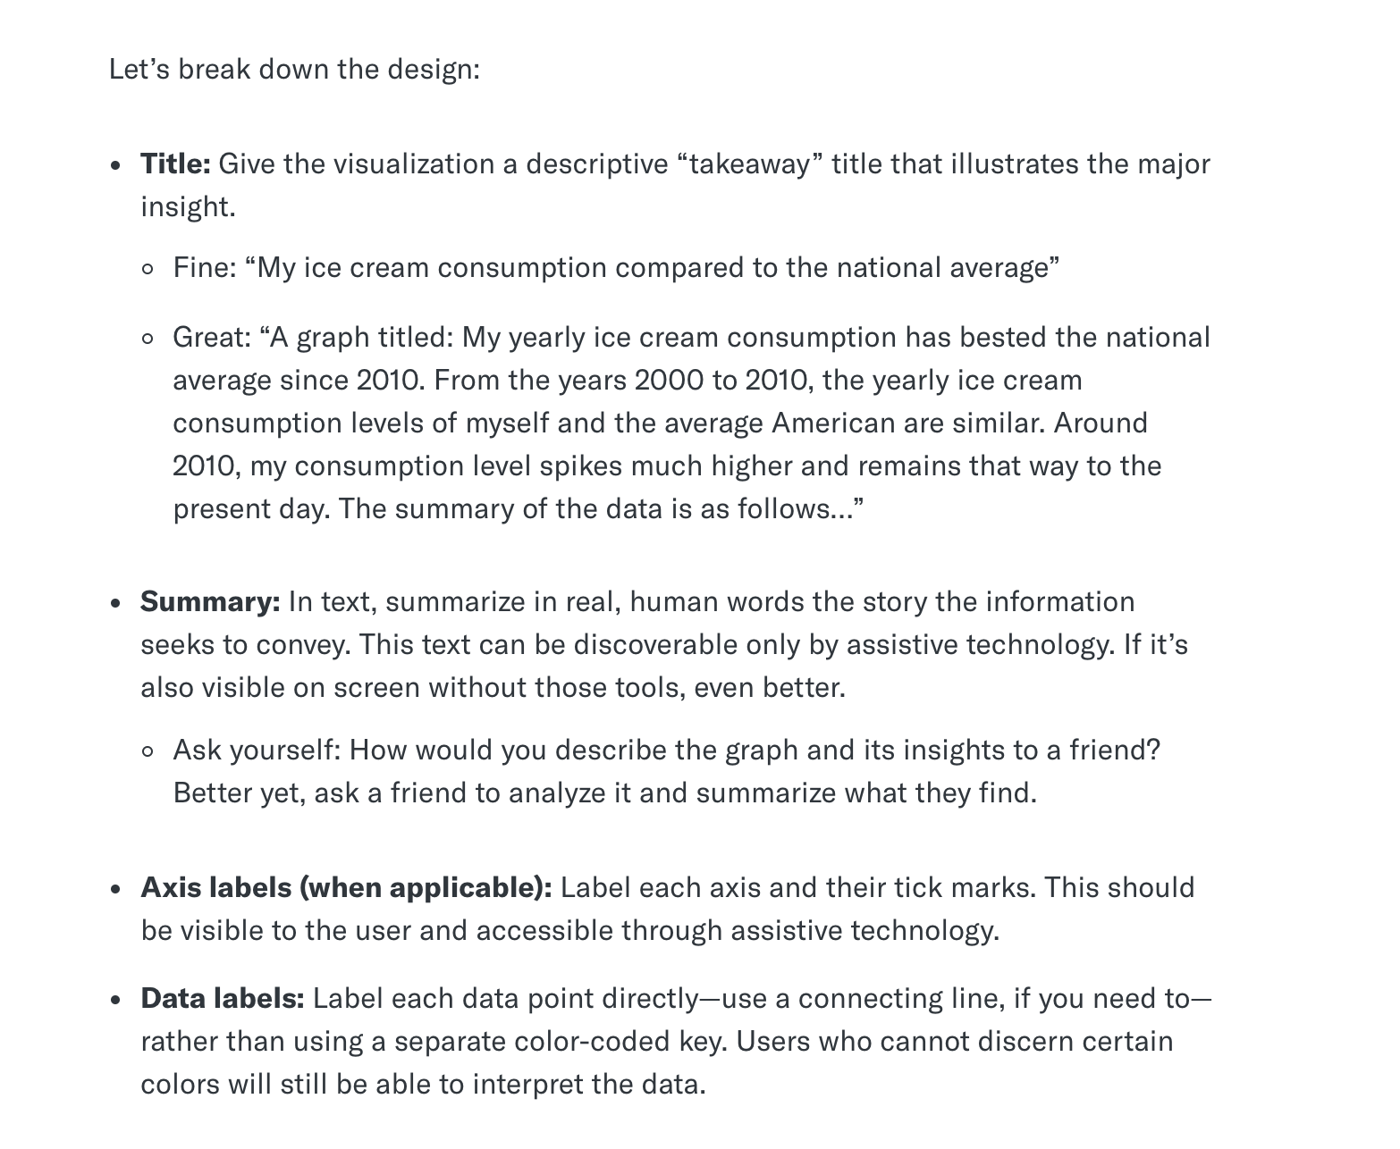
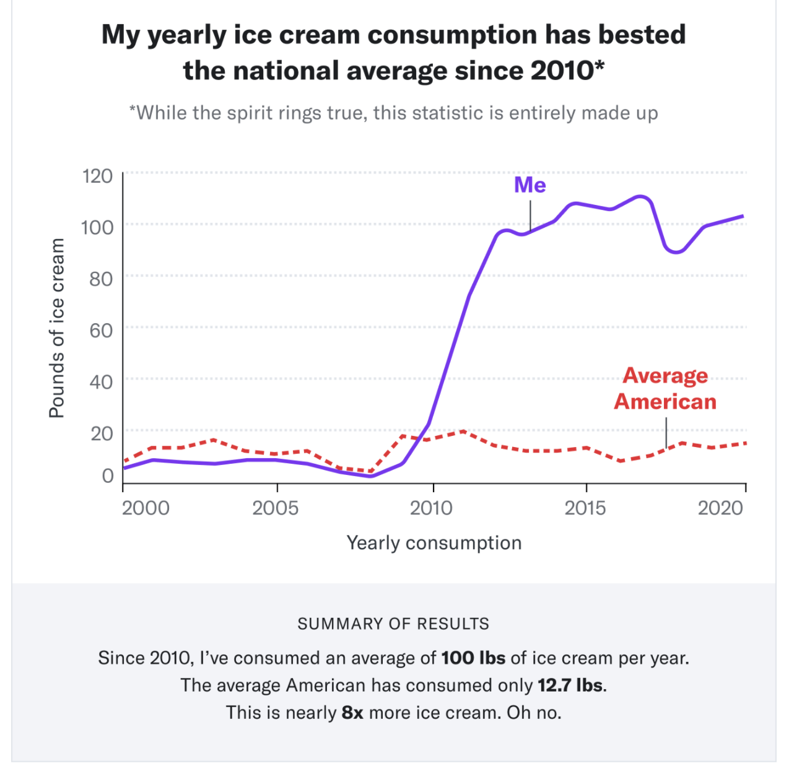
Web Content Accessibility Guidelines

Slide 9
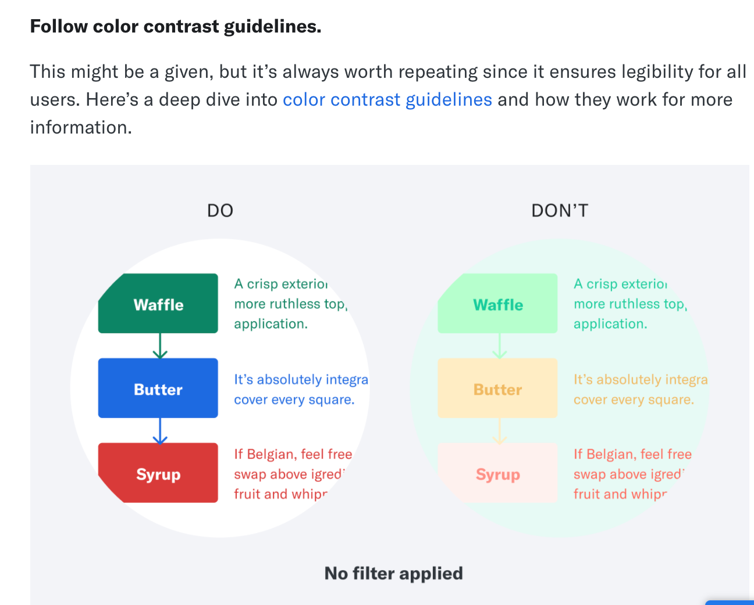
Follow color contrast guidelines.

Slide 10
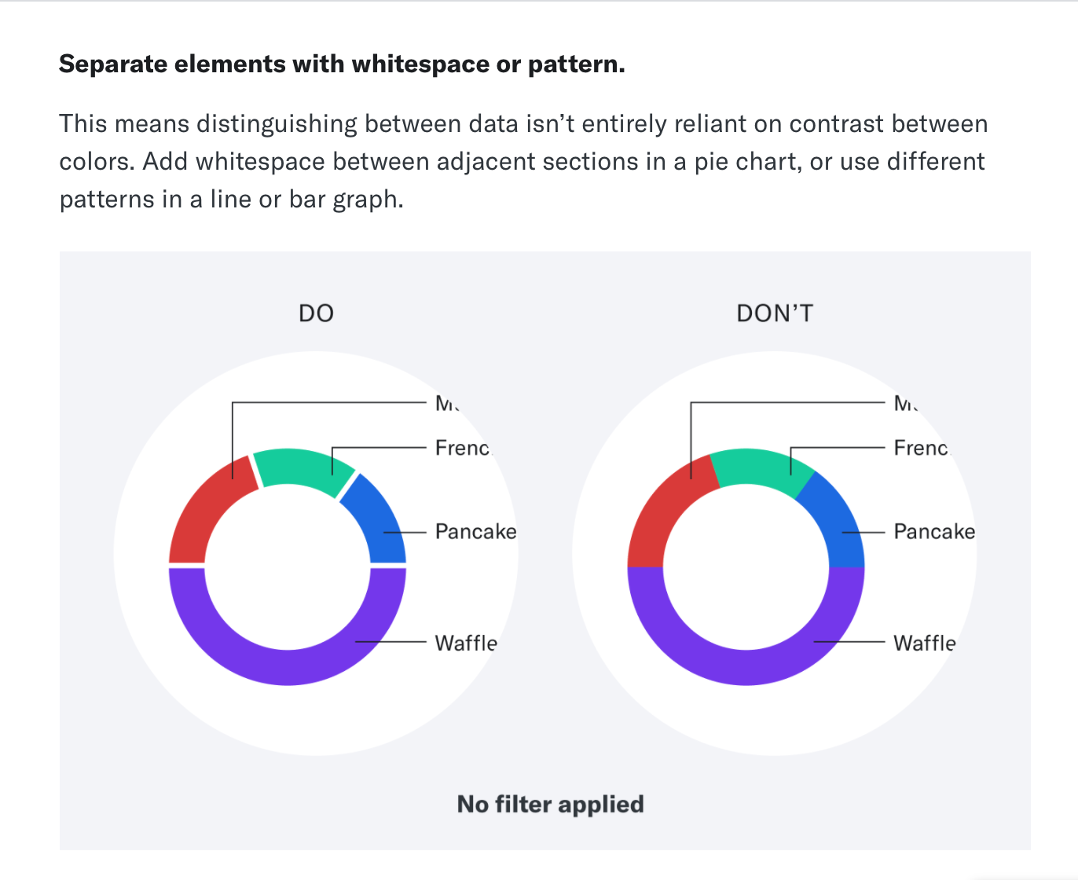
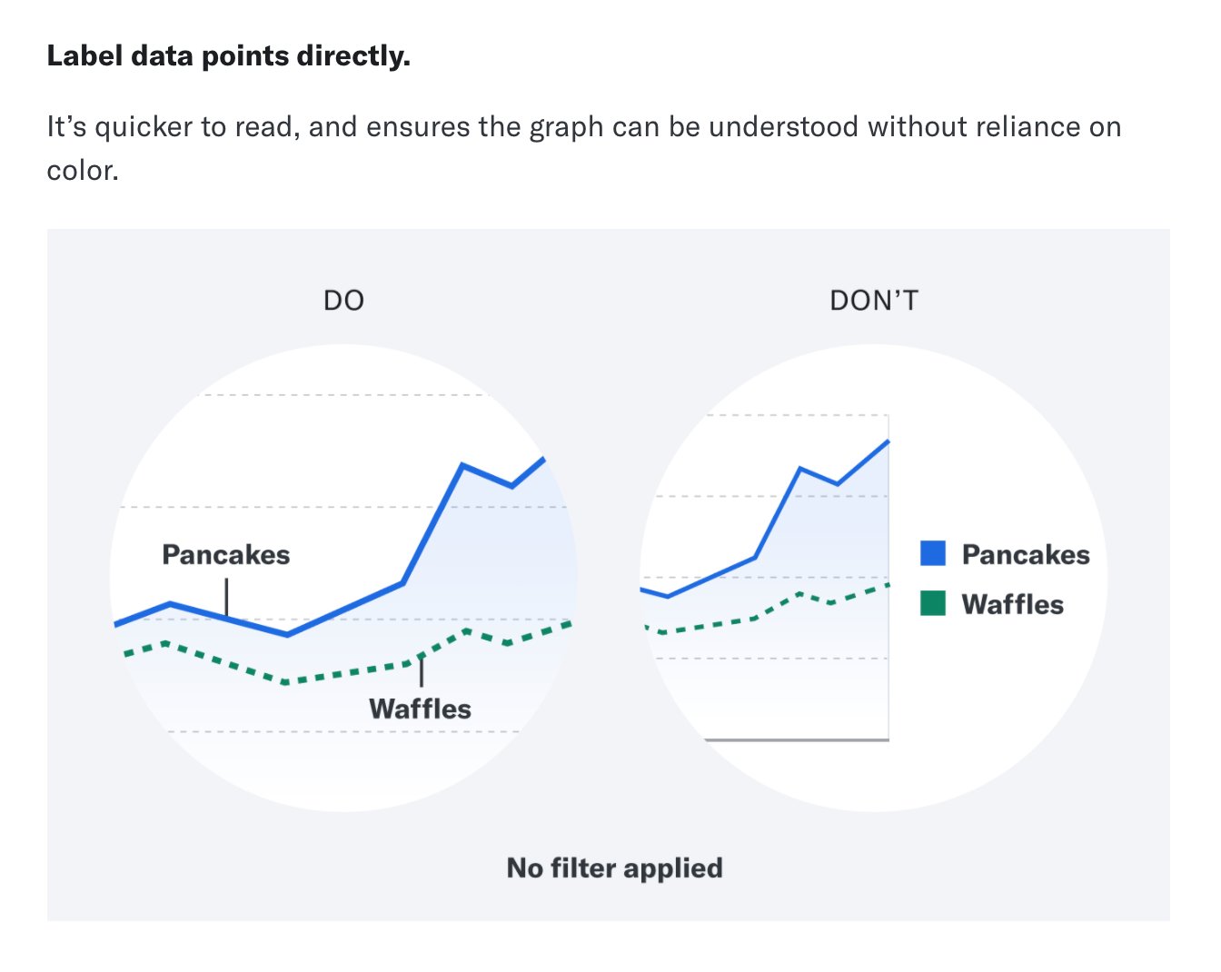

Slide 11
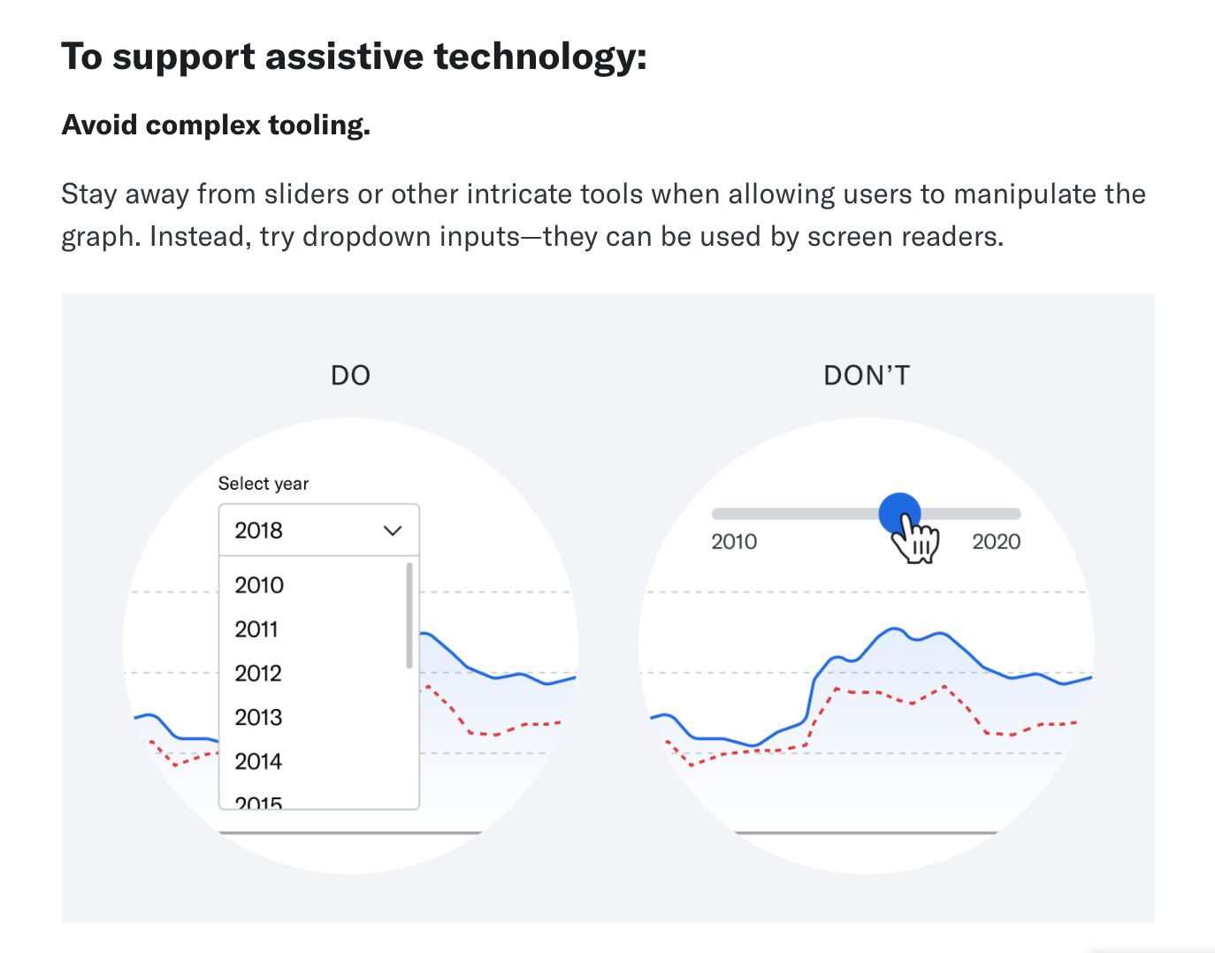

Slide 12
Visualization examples

Slide 13
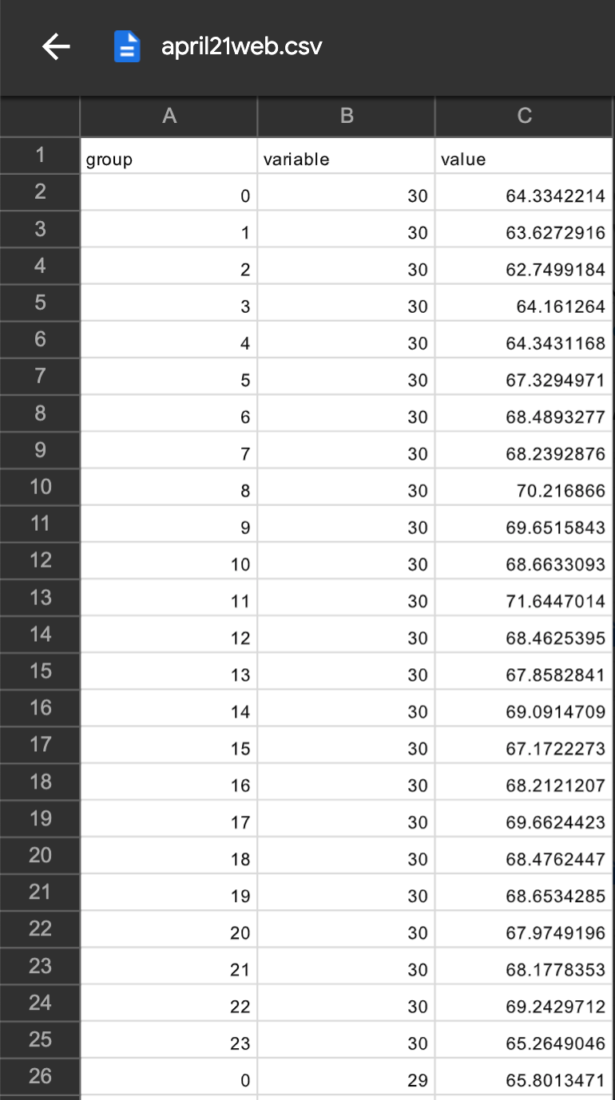
Datasets
Questions
How does the noise compare at different sensor locations?
Is there a temporal pattern to the noise?
What days of the week are the loudest?
What hours are the loudest?
In each csv file:
group = hour
variable = day
value = avg SPL

Slide 14
Challenges in visualizing longitudinal data: Continuity
The 24 hours of the day are a continuous cycle. The “day” doesn’t end at any arbitrary time. A normal single day ends at 11:59pm, but that’s just an imaginary line. When you’re talking about a generalized 24 hours, 11:59pm leads straight into midnight, which continues on to 1am. And sometimes the most interesting trends are in those hours on either side of midnight.
Many line or bar charts that deal with the 24-hour cycle simply pick a point at which the chart starts and ends. Sometimes the charts go from 12am-12am, sometimes they use ranges like 4am-4am (which puts the break during a time when most people are sleeping). For specific data this is often acceptable, but in general it is a limitation (How can you pick an arbitrary time to break the data? How are you sure the most interesting part of the data doesn’t overlap when the chart begins and ends?)

Slide 15
Visualization examples: Line Graph

Slide 16
Line Chart
Description:
The easiest way to display the longitudinal data. Line Graphs are used to display quantitative values over a continuous interval or time period. A Line Graph is most frequently used to show trends and analyse how the data has changed over time.
Typically these charts begin at a certain hour (often midnight) and show 24 unique bars or data points, ending at the same time they started.
Advantages:
Useful for representing continuous data, such as change over time
Allows possible extrapolation of data
Having a line constructed from multiple data points can allow you to make estimates of missing data
Allows comparison of two or more items to see if there is any kind of connection or relationship
Disadvantages:
Can be difficult to determine exact values at a given point of the graph
Too many lines, or even two lines that have values that are too similar, can make comparing data difficult

Slide 17
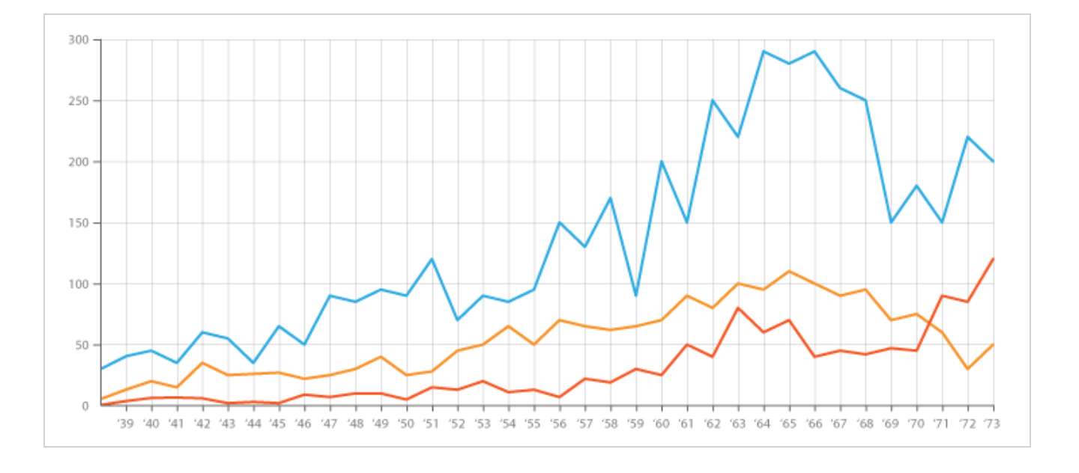
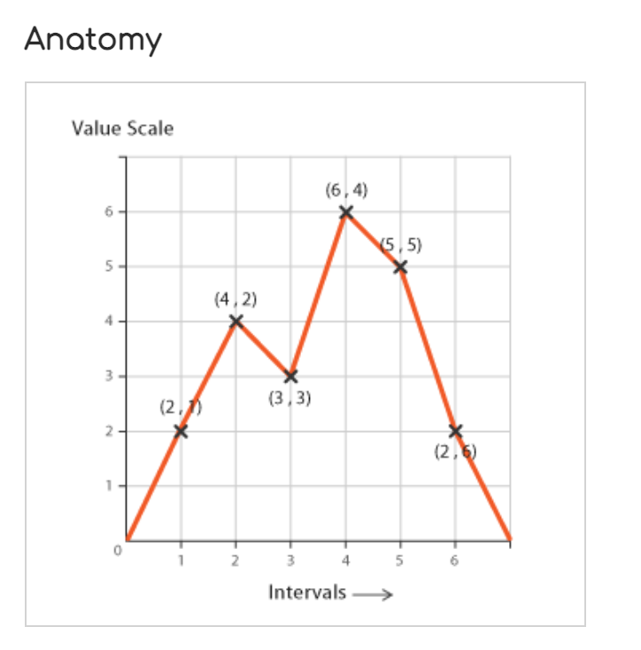
Line Chart

Slide 18
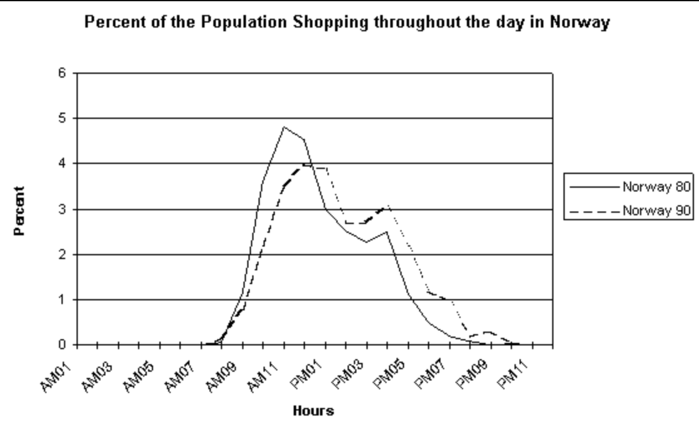
Line Charts Example 1
One relevant example of a line chart is the following figure that shows the percentage of people shopping at any given time of the day
The graph shows hourly data

Slide 19
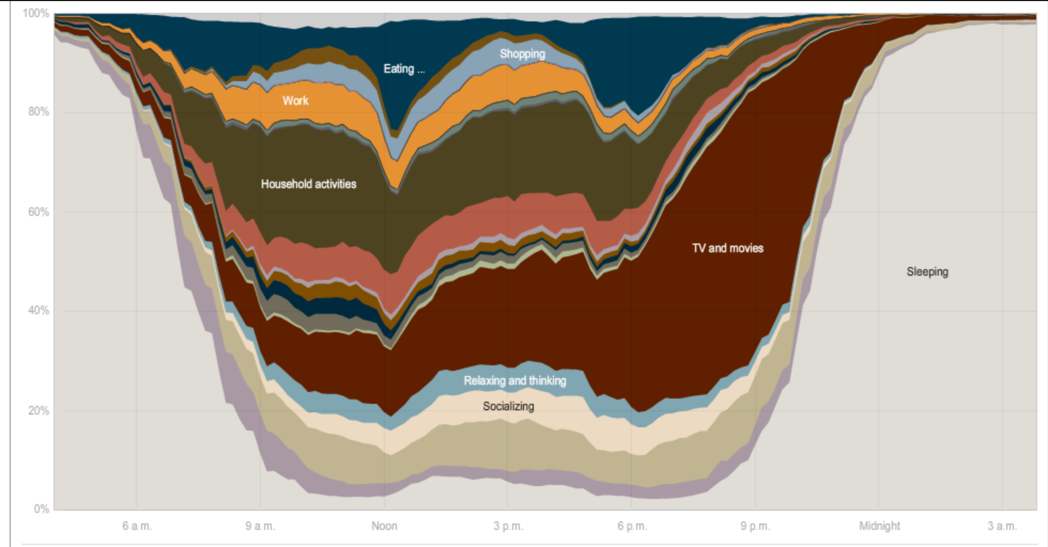
Line Charts Example 2
Another example from the New York Times analyzes similar data about the typical activities that people perform throughout the day.
The NYT chart starts at 4am instead of midnight, which does a bit of a better job showing the trend of when people go to sleep than an x-axis that starts at midnight. The 4am-4am axis does a good job at showing activities during the day

Slide 20
Visualization examples:
Radar Chart (Polar Spiral Clock)

Slide 21
Radar Chart
Description:
Each variable is provided with an axis that starts from the centre. All axes are arranged radially, with equal distances between each other, while maintaining the same scale between all axes. Each variable value is plotted along its individual axis and all the variables in a dataset and connected together to form a polygon.
Advantages:
Useful for seeing which variables have similar values or if there are any outliers amongst each variable.
Useful for seeing which variables are scoring high or low within a dataset, making them ideal for displaying performance.
Disadvantages:
Having multiple polygons in one Radar Chart makes it hard to read, confusing and too cluttered. Especially if the polygons are filled in, as the top polygon covers all the other polygons underneath it.
Having too many variables creates too many axes and can also make the chart hard to read and complicated. So it's good practice to keep Radar Charts simple and limit the number of variables used.
Another flaw with Radar Charts is that they’re not so good for comparing values across each variable. Even with the aid of the spiderweb-like grid guide. Comparing values all on a single straight axis is much easier.

Slide 22
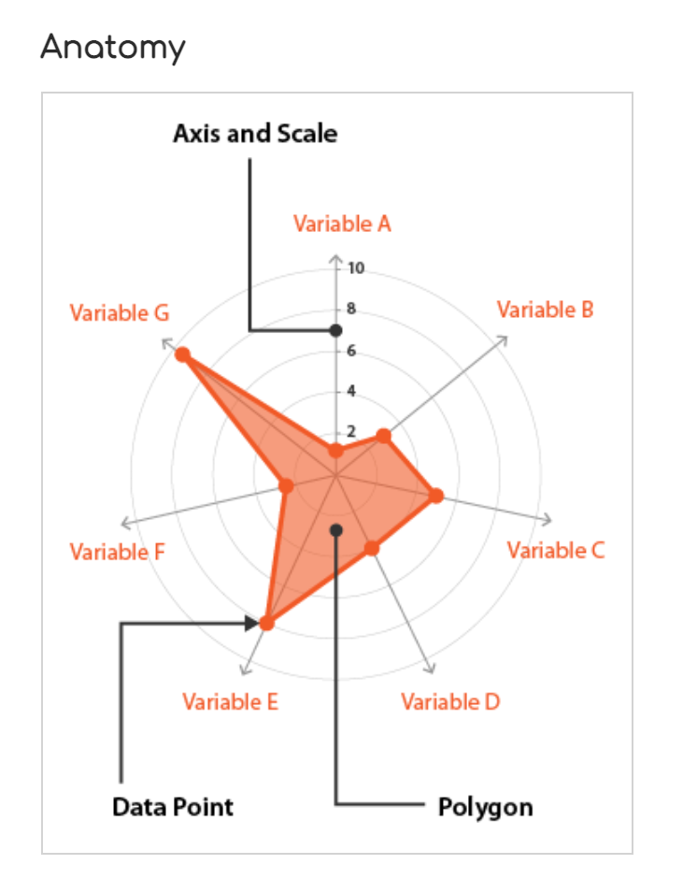
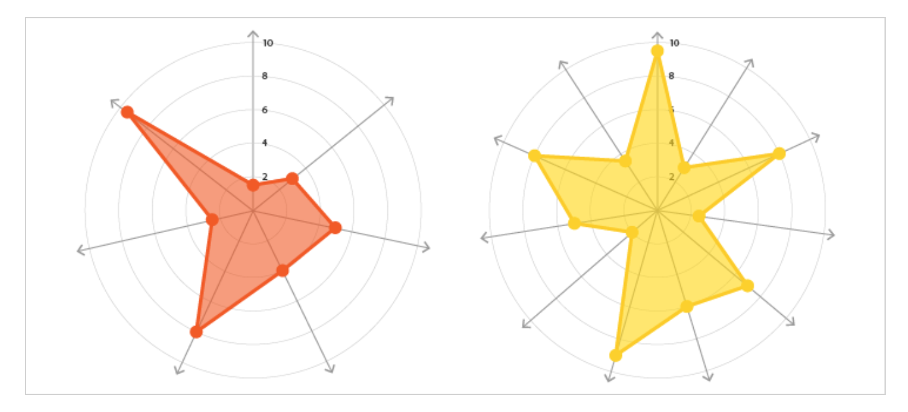
Radar Chart

Slide 23
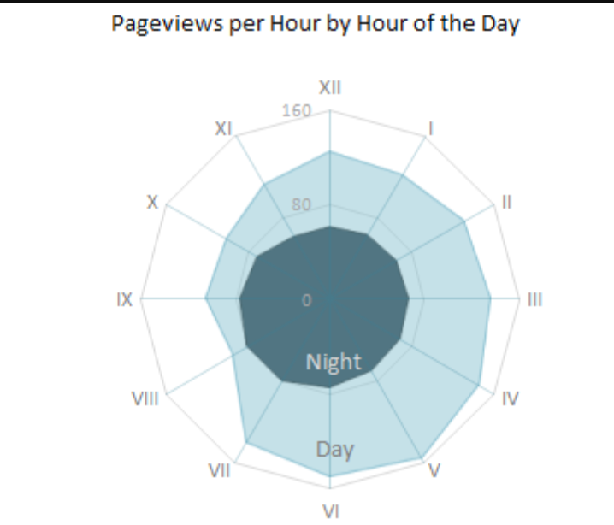
Radar Chart Example 1
One relevant example of a radar chart is the following figure created by Jorge Camos that plots the data on a single “clock face,” showing two 12 hour charts overlaid on top of each other.

Slide 24
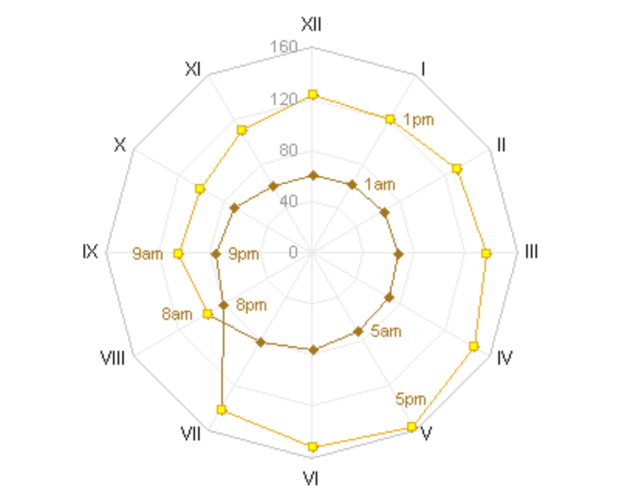
Radar Chart Example 2
The chart in example 1 was further modified by Jon Peltier to make the radar chart to show a line series connecting the hours.

Slide 25
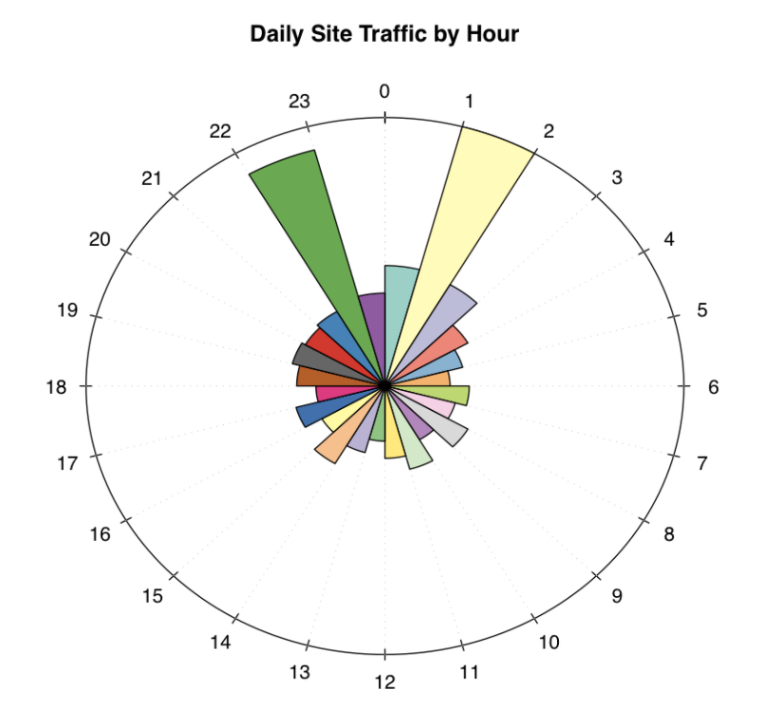
Radar Chart Example 3
The chart displays daily site traffic by hour (relevant to our project)

Slide 26
Visualization examples: Nightingale Rose Chart

Slide 27
Nightingale Rose Chart
Description:
This chart was famously used by statistician and medical reformer, Florence Nightingale to communicate the avoidable deaths of soldiers during the Crimean war.
Nightingale Rose Charts are drawn on a polar coordinate grid. Each category or interval in the data is divided into equal segments on this radial chart. How far each segment extends from the centre of the polar axis depends on the value it represents.
Advantages:
Each ring from the centre of the polar grid can be used as a scale to plot the segment size and represent a higher value. Therefore, it’s important to notice with Nightingale Rose Charts that it’s the area, rather than the radius of a segment that represents its value.
Disadvantages:
The major flaw with Nightingale Rose Charts is that the outer segments are given more emphasis because of their larger area size. This disproportionately represents increases in value.

Slide 28
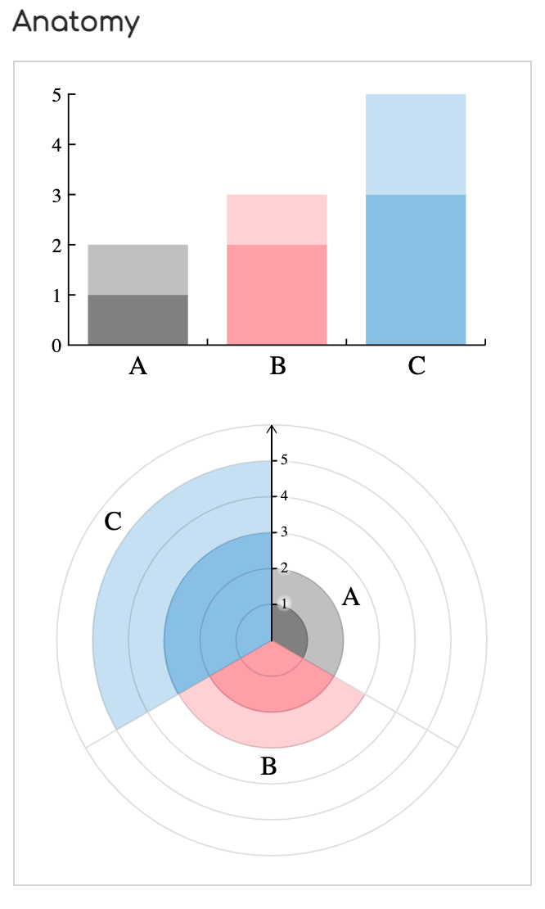
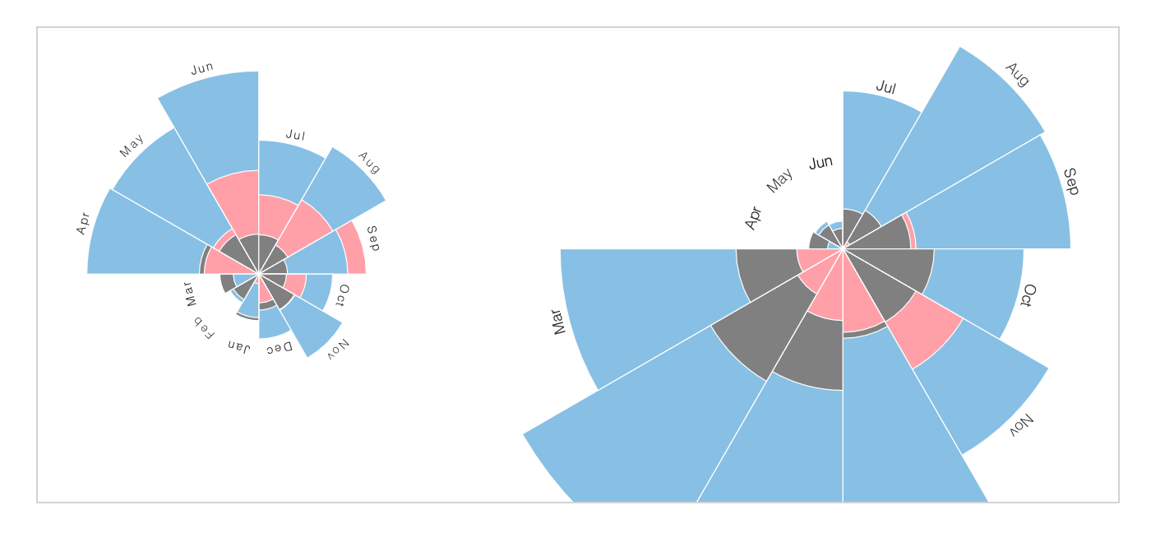
Nightingale Rose Chart

Slide 29
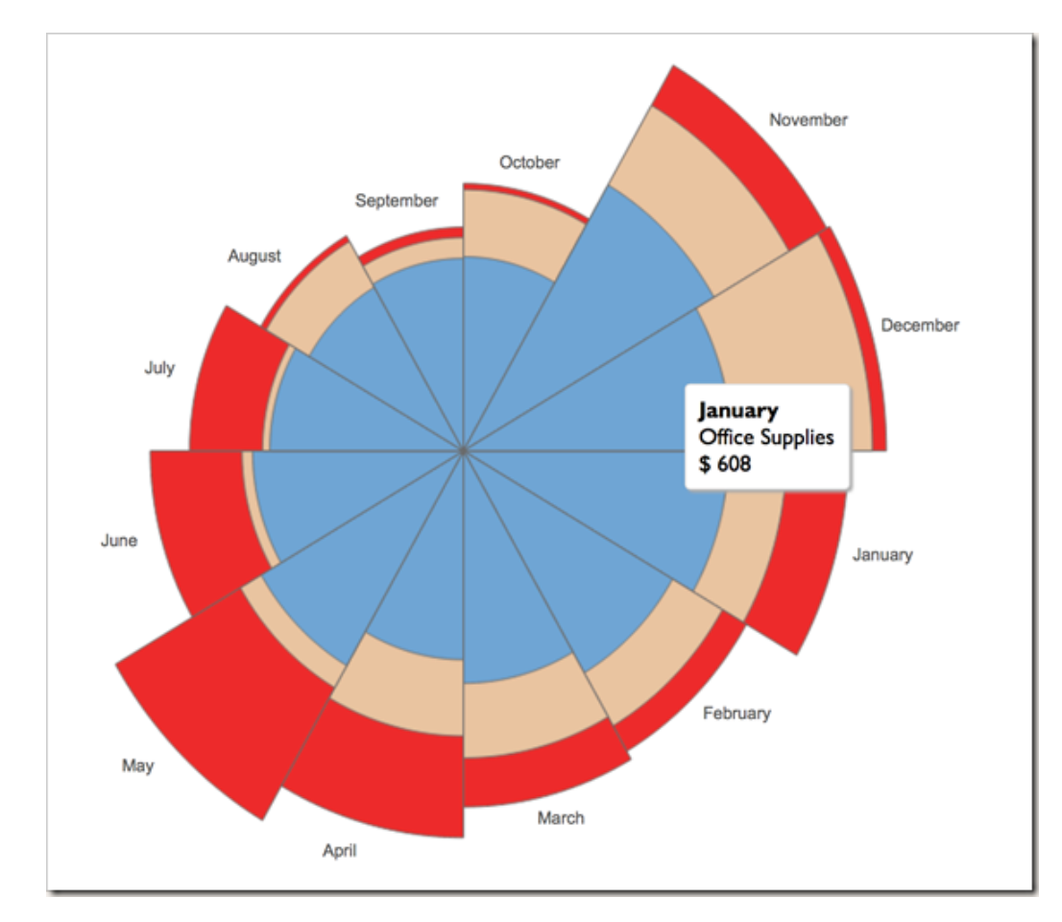
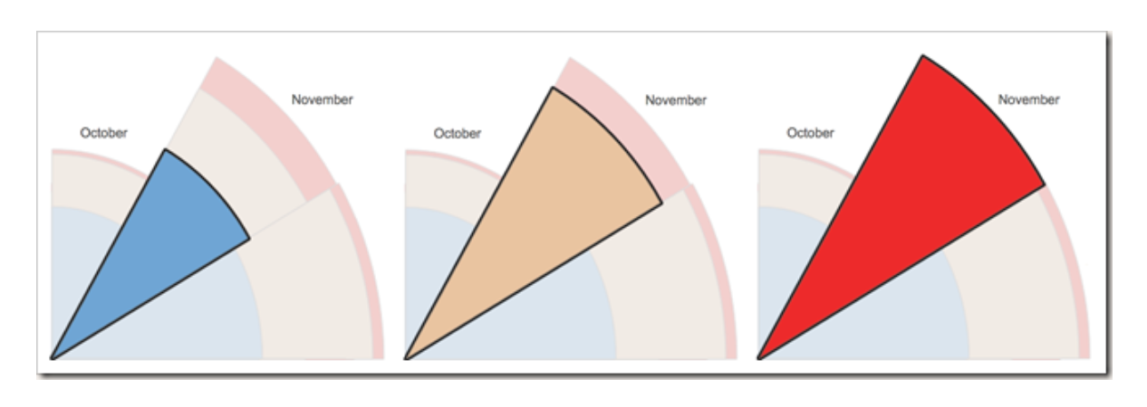
Nightingale Rose Chart Example 1
This example comes from Tableau. Since each of the slices represent sales for that particular month and department, you will notice that the entire slice gets highlighted when you make a selection instead of just the band visible in the chart as you’d expect.

Slide 30
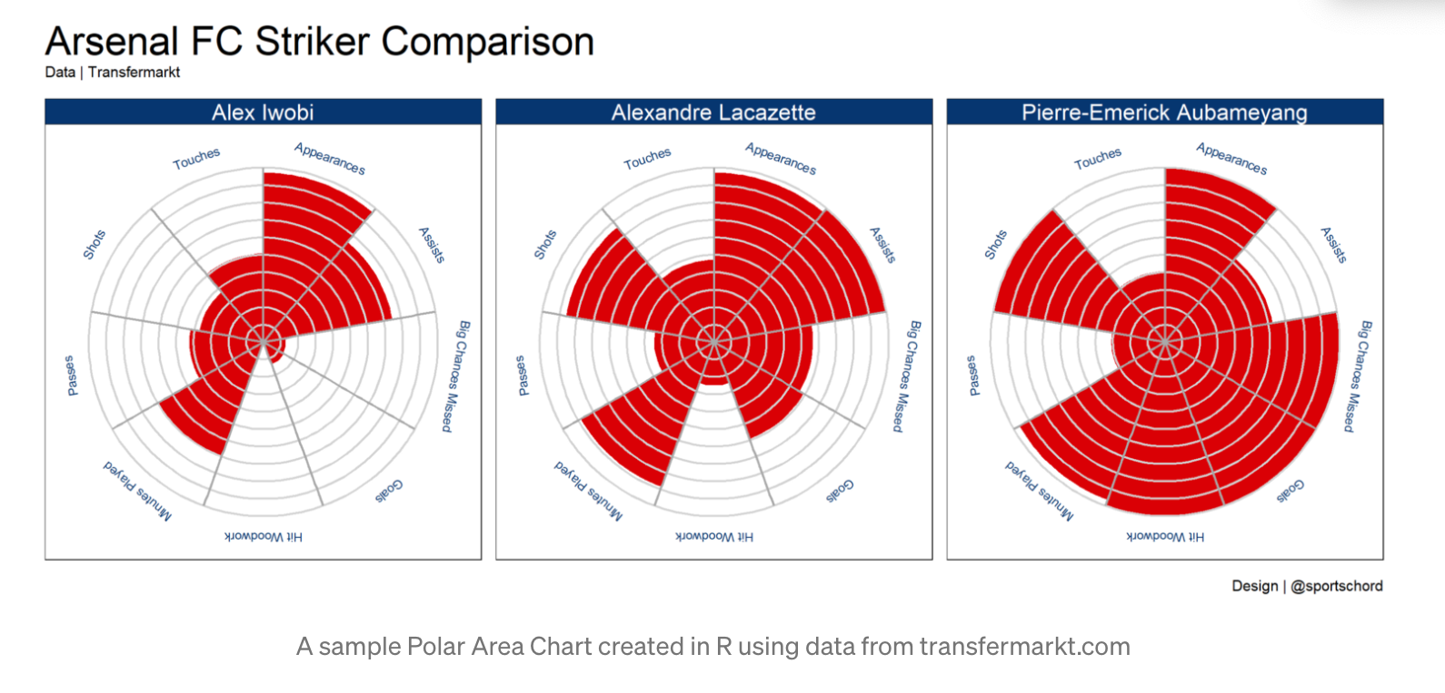
Nightingale Rose Chart Example 2
Example of creating a Rose chart with detailed instructions
We can display 12 charts for each month.

Slide 31
Visualization examples: Double-time bar chart

Slide 32
Double-time bar chart motivation
Why not usual bar chart for time series?
Generally, visualization of time series data using bar charts has the following challenges:
the break in the data between 11pm and midnight
To summarize, the first problem has to do with being able to understand the trends that occur around midnight (where this chart breaks the data).
This is only problematic when something interesting is happening around midnight (or whenever you choose to have your chart begin/end).
the difficulty understanding the context of the time
The second point about context has to do with the fact that I don’t think about my days as starting at midnight and ending at 11:59pm.
A more accurate representation of how I think of my days is that they start sometime when I wake up, usually around 7am, and they are broken up into “day-time” and “night-time”, and they end more or less when I go to sleep.
The simple bar chart doesn’t solve these problems well. It presents a hard break in the data, forcing the viewer to mentally connect the end of the chart with the beginning. And it also forces the viewer to think about the days in the context of midnight – 11pm, which is not the natural categorization system we have for the hours of the day.

Slide 33
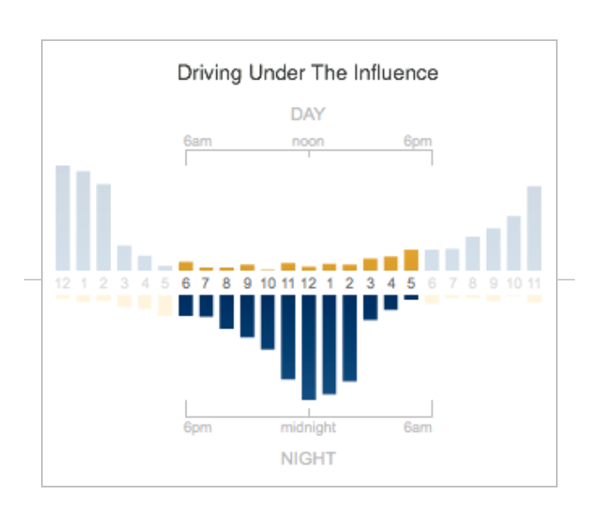
Double-time bar chart Example 1
The chart still uses simple bars in a linear chart. But the data is actually shown twice in the chart. The top part of the chart is the exact same histogram chart with 24 bars that we had before, going from midnight to 11pm. The bottom part is the same data (upside down), but it starts instead at noon and goes to 11am. It’s shifted by 12 hours compared to the top chart. Imagine taking the top chart, flipping it upside down, then shifting it over to the right by 12 bars.
The example graph to the left shows time patterns for Driving under the influence.

Slide 34
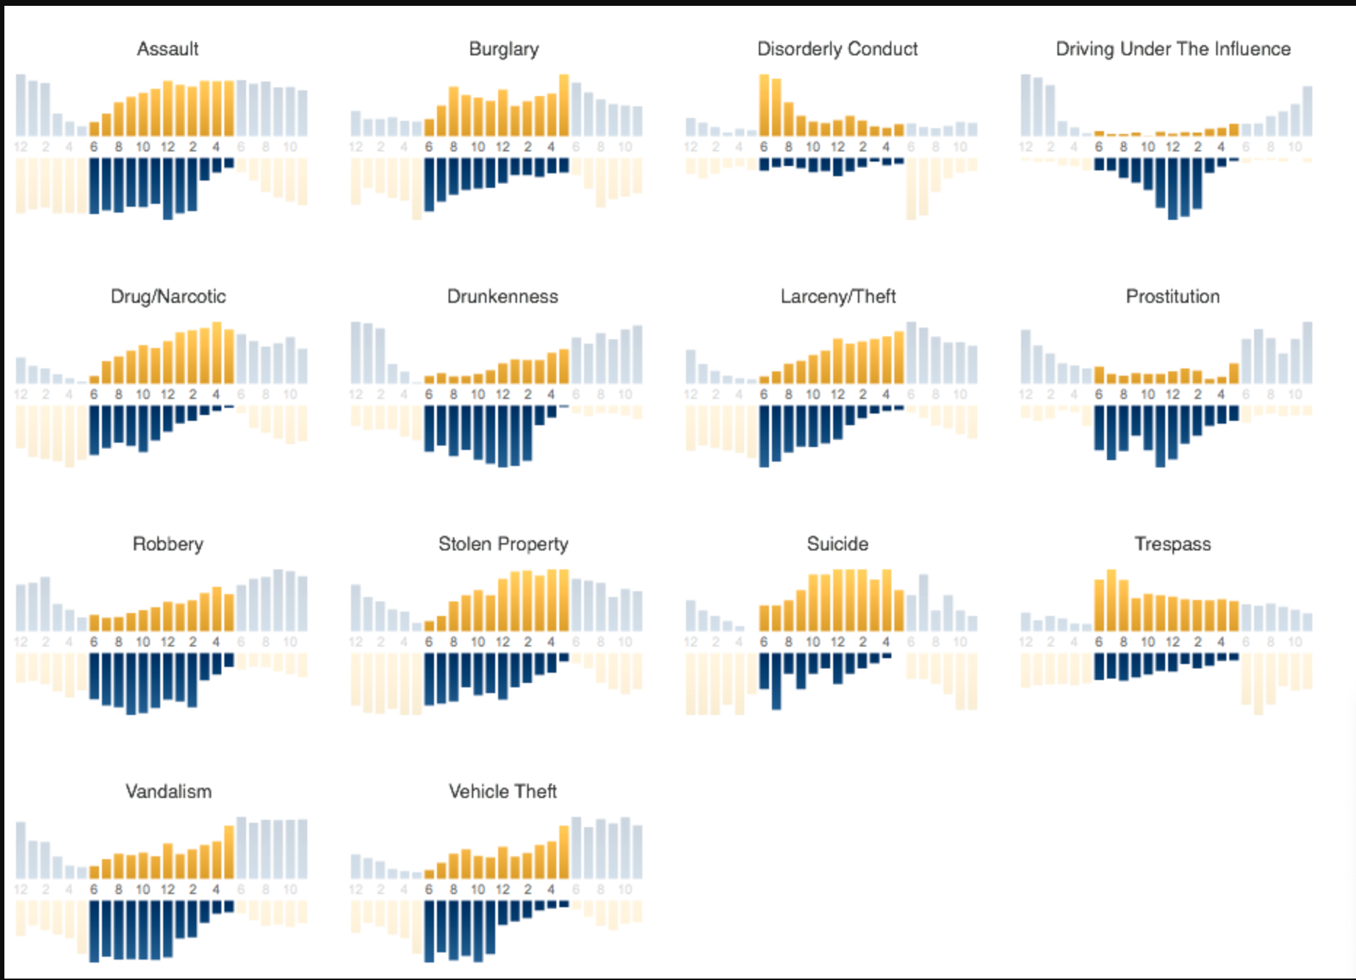
Double-time bar chart Example 2
In the graph, the same approach can be used to compare many different types of crimes.
For our project, we could have have 12 graphs for each month displayed together
Notes:
What happens when the axes shift by 90 degrees

Slide 35
Visualization examples: Bubble chart

Slide 36
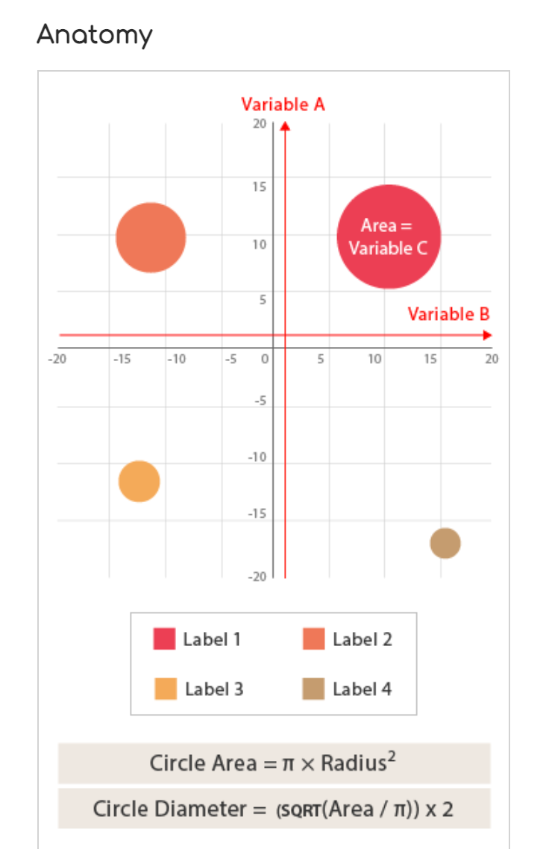
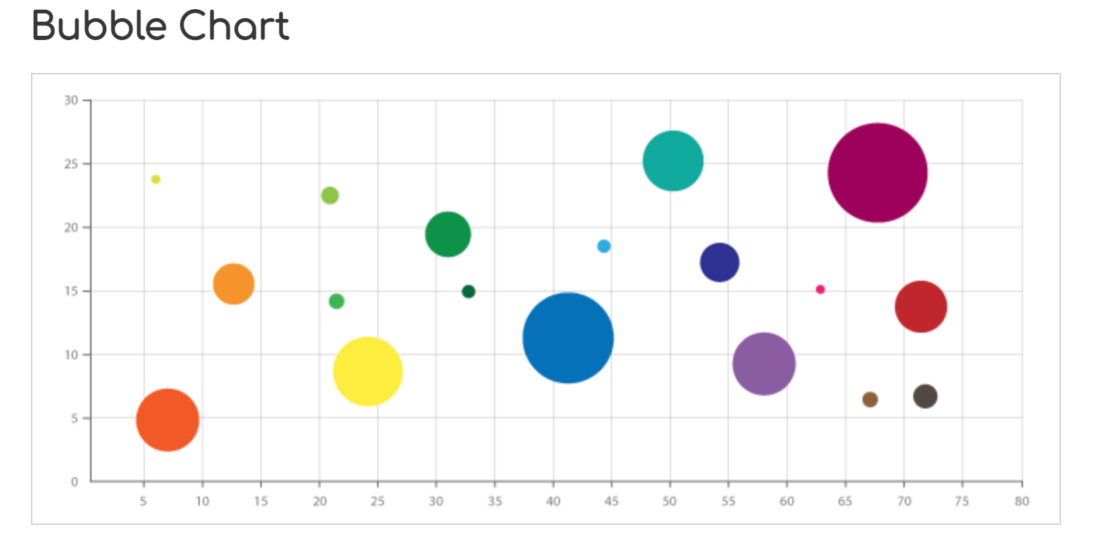
Bubble Chart
Notes:
Description

Slide 37
Bubble Chart Pros and Cons
Description. Each point is assigned a label or category . Each plotted point then represents a third variable by the area of its circle. Colours can also be used to distinguish between categories or used to represent an additional data variable. Time can be shown either by having it as a variable on one of the axis or by animating the data variables changing over time.
Use cases:
Bubble Charts are typically used to compare and show the relationships between categorised circles, by the use of positioning and proportions. The overall picture of Bubble Charts can be used to analyse for patterns/correlations.
Advantages:
display three variables without using 3D graphs; visual size makes it very easy to make relative comparisons; Conveys same information as a line graph
Disadvantages:
Too many bubbles can make the chart hard to read, so Bubble Charts have a limited data size capacity. This can be somewhat remedied by interactivity: clicking or hovering over bubbles to display hidden information, having an option to reorganise or filter out grouped categories.
Due to circle sizes, can be difficult to ascertain actual values; difficult to read and understand; cannot be used to display a lot of data.

Slide 38
Visualization examples (optional) :
Stem and leaf plot

Slide 39
Stem and Leaf plot Pros and Cons
Description. Stem & Leaf Plots are a way of organising data via their place value to show the distribution of data. Place values are shown ascending downwards on a "stem" column, typically but not always in tens. Data that is within each place value is listed and extends sideways from it as a "leaf".
So in a dataset of (4,11,2,20,17,23) the data would be arranged based on their 10's digit but have only their 1's digit displayed:
0 - 2, 4
10 - 1, 7
20 - 0, 3
Advantages:
As well as giving readers a quick overview of the data distribution, Stem & Leaf Plots are useful for highlighting outliers and finding the mode. Displaying the data (mostly) raw makes Stem & Leaf Plots useful as a reference tool, such as a public transport schedule. If you have two datasets, then a back-to-back or double Stem & Leaf Plot can be used to compare the two datasets together.
Disadvantages:
In terms of weaknesses, Stem & Leaf Plots are limited in the size of dataset they can handle. Too little and they become pointless, too much and the chart becomes over-cluttered.

Slide 40
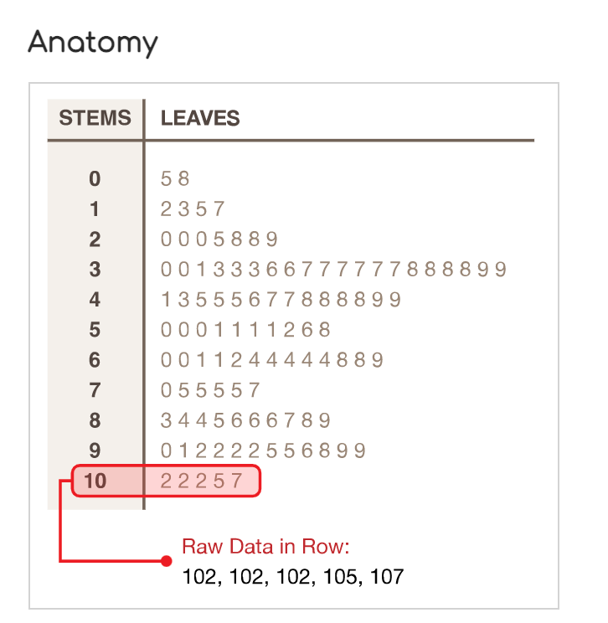
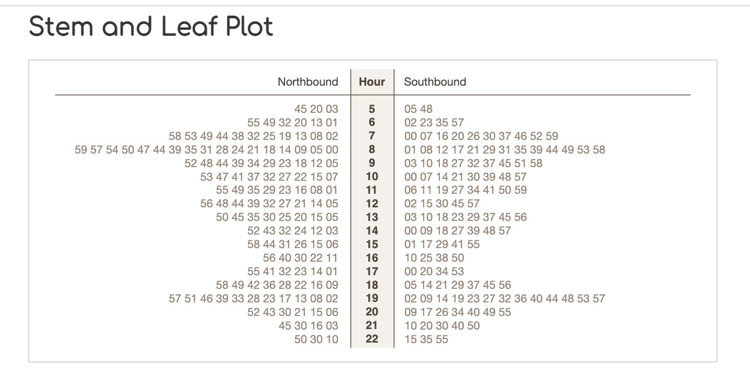
Notes:
Description
As known as a Stemplot, Stem & Leaf Display.
Stem & Leaf Plots are a way of organising data via their place value to show the distribution of data. Place values are shown ascending downwards on a "stem" column, typically but not always in tens. Data that is within each place value is listed and extends sideways from it as a "leaf".
So in a dataset of (4,11,2,20,17,23) the data would be arranged based on their 10's digit but have only their 1's digit displayed:
0 - 2, 4
10 - 1, 7
20 - 0, 3
As well as giving readers a quick overview of the data distribution, Stem & Leaf Plots are useful for highlighting outliers and finding the mode. Displaying the data (mostly) raw makes Stem & Leaf Plots useful as a reference tool, such as a public transport schedule. If you have two datasets, then a back-to-back or double Stem & Leaf Plot can be used to compare the two datasets together.
In terms of weaknesses, Stem & Leaf Plots are limited in the size of dataset they can handle. Too little and they become pointless, too much and the chart becomes over-cluttered.

Slide 41
OSHA permissible daily exposures
115 dB – 15 mins
110 dB – 30 mins
105 dB – 1 hour
102 dB – 1.5 hours
100 dB – 2 hours
97 db – 3 hours
95 dB – 4 hours
92 dB – 6 hours
90 dB – 8 hours
85 dB – 16 hours

Slide 42
Level indicators
140 dB – Pain threshold
135 dB – Fireworks
130 dB – Jackhammer
120 dB – Ambulance Sirens
110 dB - Shouting
100 dB – Train
90 dB – Hairdryer
80 dB – Washing machine
70 dB – City traffic
60 dB – Conversation
50 dB
40 dB – Refrigerator

Slide 43
